Slide 1
Temporal Network Epistemology

Slide 2
Epistemic model
K agents represent a group of people
multi-armed bandit
(|E| < 0.5)
picking the better arm as Beta better than Alpha
test and update Beta result in network
run until converges.

Slide 3
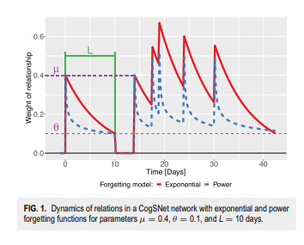
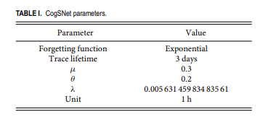
Forgetting model

Slide 4
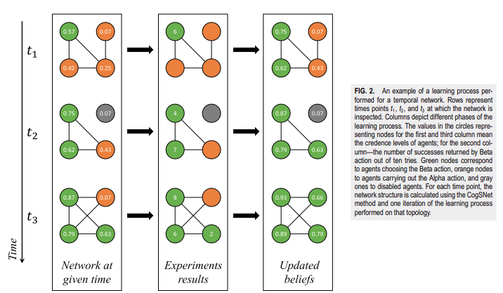
Forgetting model

Slide 5
Dataset and baseline network models
Realworld Network(NetSense)
180 students
recorded metadata on phone calls and Text messages
covers three years
7575865 events
7096844(93.7%) text messages
limited to activities between the study participants and remove duplicates: 537575
1103 points in time
frist semester 15-125 days
average 148 nodes and 157 edges
a snapshot of a temporal network created at 15th day of students’ interaction

Slide 6
Other Datasets
Erdös–Rényi(ER) model(Random)
node: 148
edge occurrence probability: 0.0144
Watts–Strogat(WS) model (Small-world)
mean degree: 2
closest even intege: 2.12
rewiring probability:0.5
Barabási–Albert(BA) mode (Scale-Free)
number of edges to attach from a new node to existing node: 2
cause 293 edges

Slide 7
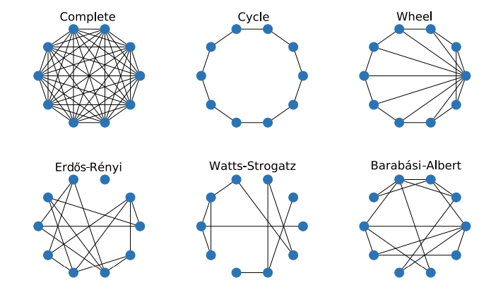
Example of six different static topologies

Slide 9
Result
for the temporal network based on the NetSense Dataset, the community can reach the correct consensus
it converges to the correct consensus is lower than most reference network models
ER Graph results having more than one connected component causing the form of communities
complete network and difficult problems would cause incorrect consensus
those who rejected better action tend to be on the periphery of the community

Slide 10
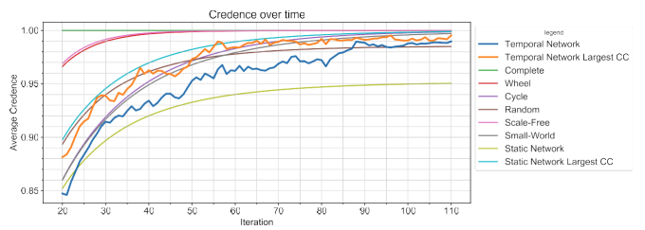
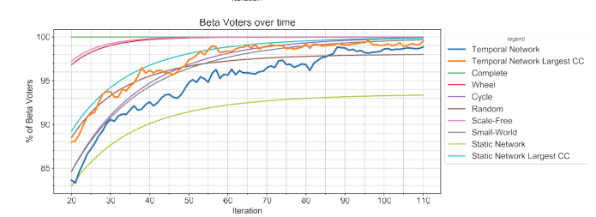

Slide 11
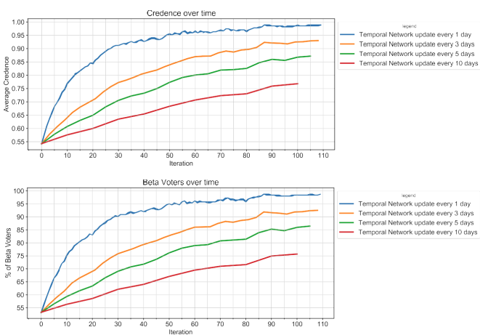

Slide 12
Personal thoughts
Beta might be worse than Alpha(E<0)

Slide 13
Q&A

Slide 14
Thank You

